Slide 1
Simulating sweeps and adaptation of quantitive traits in evolution experiments using SLiM, part I
Changyi Xiao & Neda Barghi
Qlife Quantitative Biology Winter School 2025

Slide 2
Overview
Day1
Detecting selection target
Reconstruct haplotype blocks
Day 2
SLiM simulation
Model Fitting
Drift
statistical methods
(CMH-test
Chisq-test)
Linkage (correlated frequency change)
characterize selection (e.g. selection coefficient)
Model selection
connection between simulation and experiments
summary statistics (e.g. Jaccard index)
Qlife Quantitative Biology Winter School 2025
Notes:
1.1 detecting selection target
-understand drift, effective population size and how they influence selection
-statical method detecting loci underlying selection based on the allele frequency change
1.2 reconstruct haplotype blocks
-understand linkage
-based on the correlation in allele frequency change between SNPs
-characterize selection at the haplotype scale(allele frequency change trajectories)
2.1 SLiM simulation
-learn two major selection process
-define selection model in SLiM
2.2 model fitting
-connection between simulation and empirical data
-exemplified summary statistics to measure the model fitting

Slide 3
Overview
Day1
Detecting selection target
Reconstruct haplotype blocks
Day 2
SLiM simulation
Model Fitting
Drift
statistical methods
(CMH-test
Chisq-test)
Linkage (correlated frequency change)
characterize selection (e.g. selection coefficient)
Model selection
connection between simulation and experiments
summary statistics (e.g. Jaccard index)
Qlife Quantitative Biology Winter School 2025
Notes:
1.1 detecting selection target
-understand drift, effective population size and how they influence selection
-statical method detecting loci underlying selection based on the allele frequency change
1.2 reconstruct haplotype blocks
-understand linkage
-based on the correlation in allele frequency change between SNPs
-characterize selection at the haplotype scale(allele frequency change trajectories)
2.1 SLiM simulation
-learn two major selection process
-define selection model in SLiM
2.2 model fitting
-connection between simulation and empirical data
-exemplified summary statistics to measure the model fitting

Slide 4
Day 1_1 Detecting selection target from empirical data
Qlife Quantitative Biology Winter School 2025

Slide 5
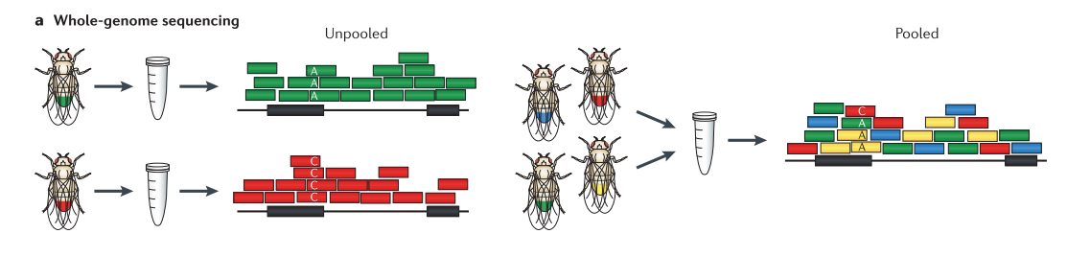
Poolseq data
Obtain information for markers at a population level
No linkage/haplotype blocks info!
Sequence (NGS) multiple individuals together to get population data
Cheaper than individual sequencing
Schlötterer et al. 2014

Slide 6
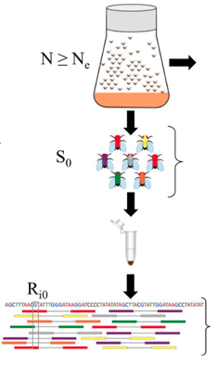
Poolseq data
Requires depth > 50x for reliable AF
disentangle low-frequency variants from sequencing errors
Sampling needs to be appropriate according to census size
Larger sample size is helpful in minimizing the sampling error
(Jonas et al, 2016)
Qlife Quantitative Biology Winter School 2025

Slide 7
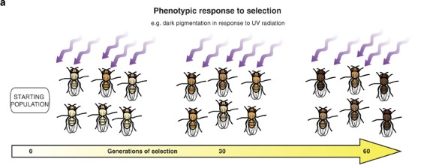
Experimental evolution
Experimental evolution is the study of evolutionary (phenotypic and genomic) changes occurring in experimental populations as a consequence of conditions (environmental, demographic, genetic, social) imposed by the experimenter.
The opportunity to study evolutionary processes experimentally in real time.
Mutation, genetic drift, and gene flow can act together with selection.
Teotónio et al. 2017
Kawecki et al. 2012
Notes:
To understand the processes that lead to, and the mechanisms underlying patterns of, genetic and/or phenotypic diversity revealed by populations across multiple generations.

Slide 8
DNA data in EE
Studying the genomic responses under a controlled environment (Experimental evolution)
Discern (linked) selection from drift using theoretical models by exploiting the whole trajectory
Focus on the dynamics of the selected alleles to learn about the adaptive scenario, to study clonal interference...
Use of time series data
Qlife Quantitative Biology Winter School 2025

Slide 9
E&R framework
Establishment of a reliable variants catalogue (standing genetic variation)
Candidates underlying the latent selected trait can be identified as having consistent allele frequency changes across replicates in a controlled environment (parallel response)
But not always
Contrast evolved and ancestral populations
Qlife Quantitative Biology Winter School 2025

Slide 10
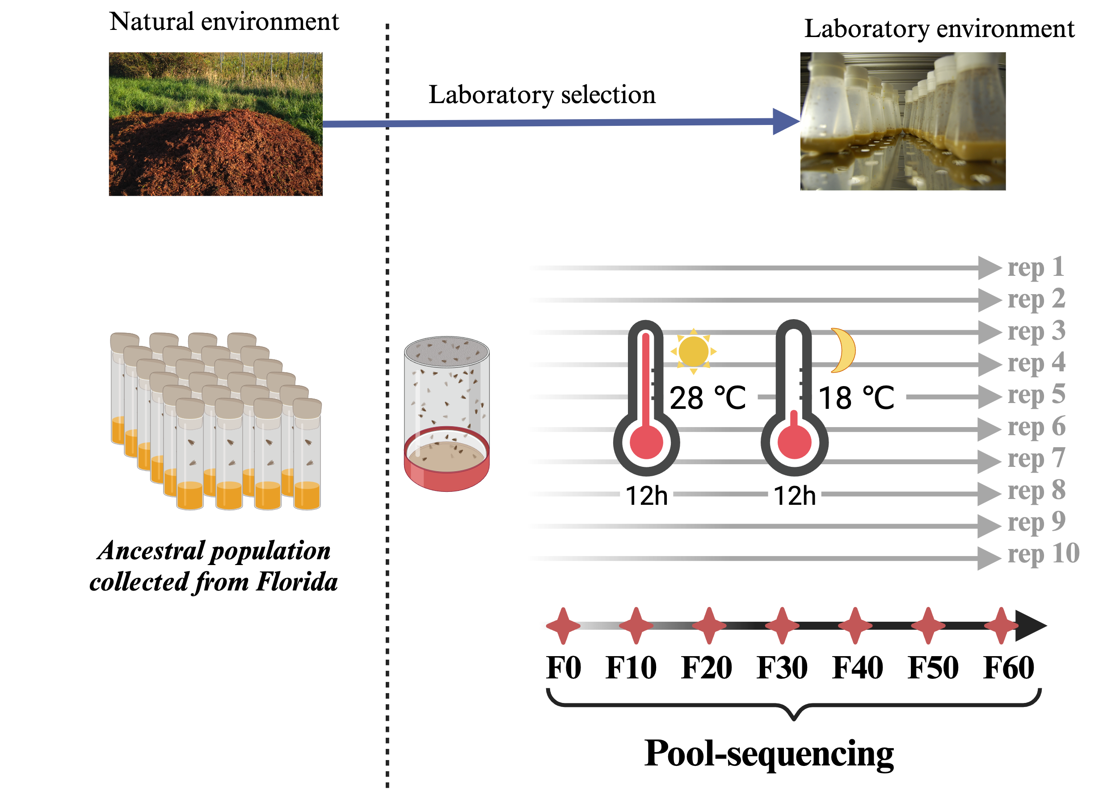
Experimental Design
Qlife Quantitative Biology Winter School 2025

Slide 11
Protocol
Estimate Ne
Quality Control
Detecting selection target
Reconstruct haplotype blocks
characterizing selection
Chisq-test
CMH-test
Allele frequency correlation
Selection coefficient
PCA
Drift

Slide 12
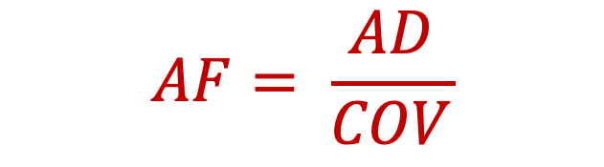
Quality control
Make sure the SNPs you are tracking are reliable.
Good alignment:
mapping quality (read)
base quality (position)
proper paired (read)
Reliable AF estimation:
Coverage
Low frequency variants
$$AF= \frac{AD}{COV}$$
Qlife Quantitative Biology Winter School 2025
Notes:
AF: selection, drift, sampling error, sequencing error

Slide 13
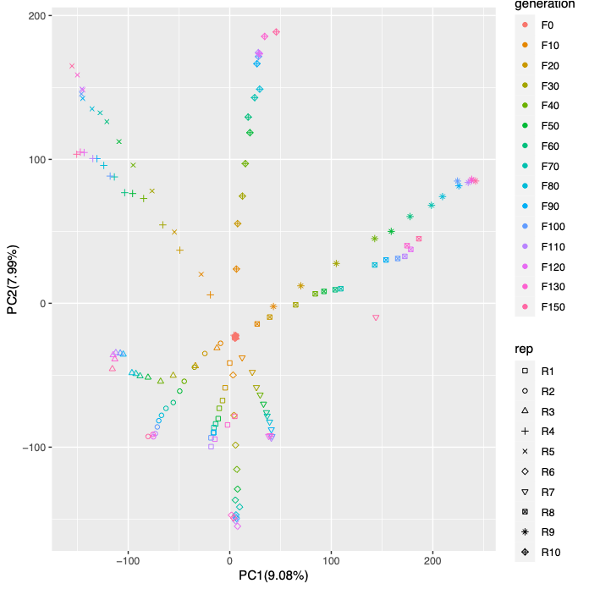
Quality control: PCA
Check the clustering of your samples with a PCA on transformed frequencies
Does the samples’ name match?
Is there any contamination in the sample?
Is there other unexpected pattern?
We transform the frequencies to normalize AFC: SNPs with AF closer to 0 or 1 are expected to change less
Qlife Quantitative Biology Winter School 2025

Slide 14
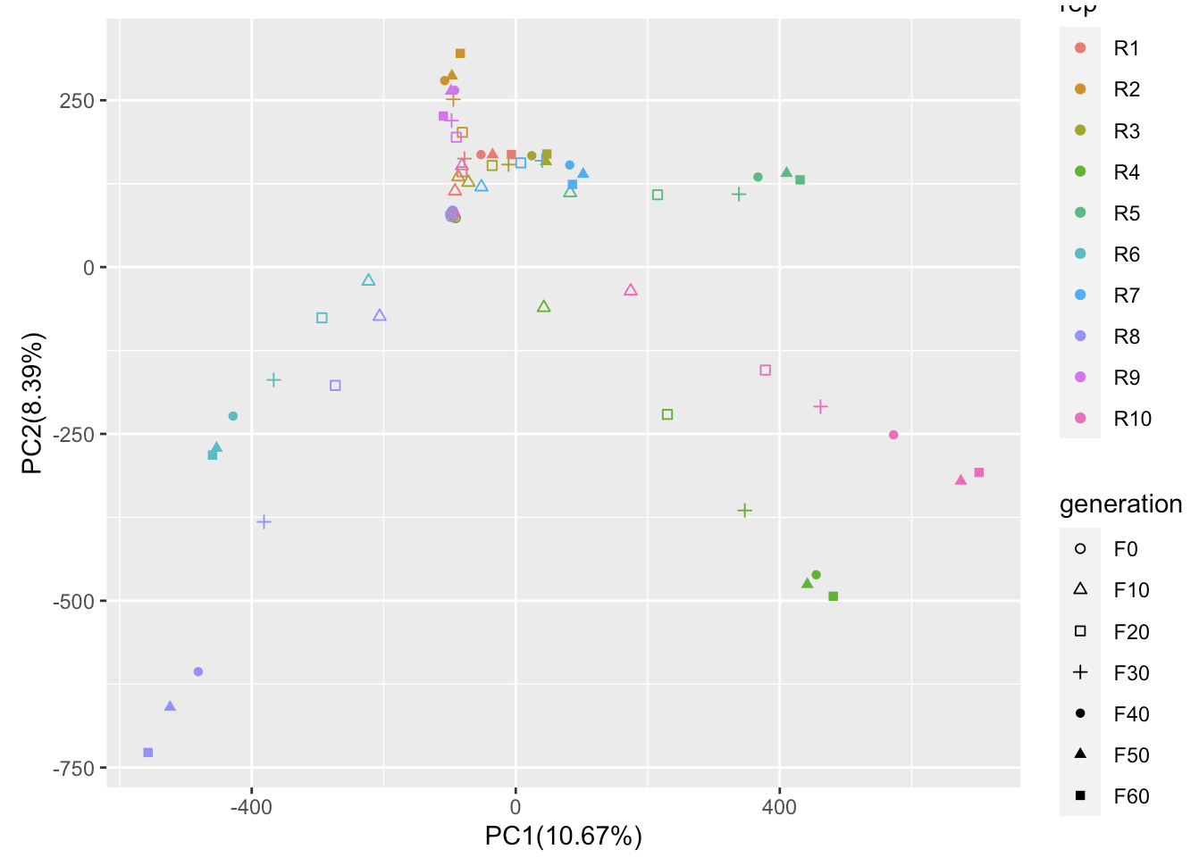
Hands on: QC
What is your expectation in the PCA results?
Qlife Quantitative Biology Winter School 2025

Slide 15
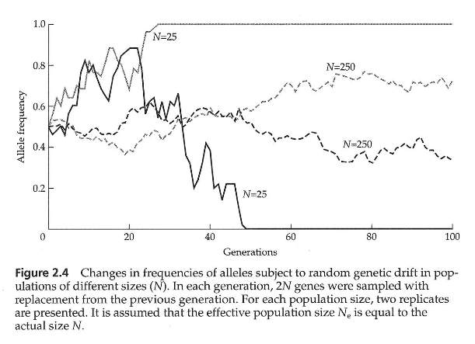
Allele frequency can change other than selection-- Genetic Drift
Changes in allele frequencies due to stochastic (independent of external and heritable factors) sampling variation (in offspring number) in a finite population
Several models have been proposed. The most commonly used models are the Wright-Fisher model and the Moran model.
Bodmer and Cavalli-Sforza 1976

Slide 16
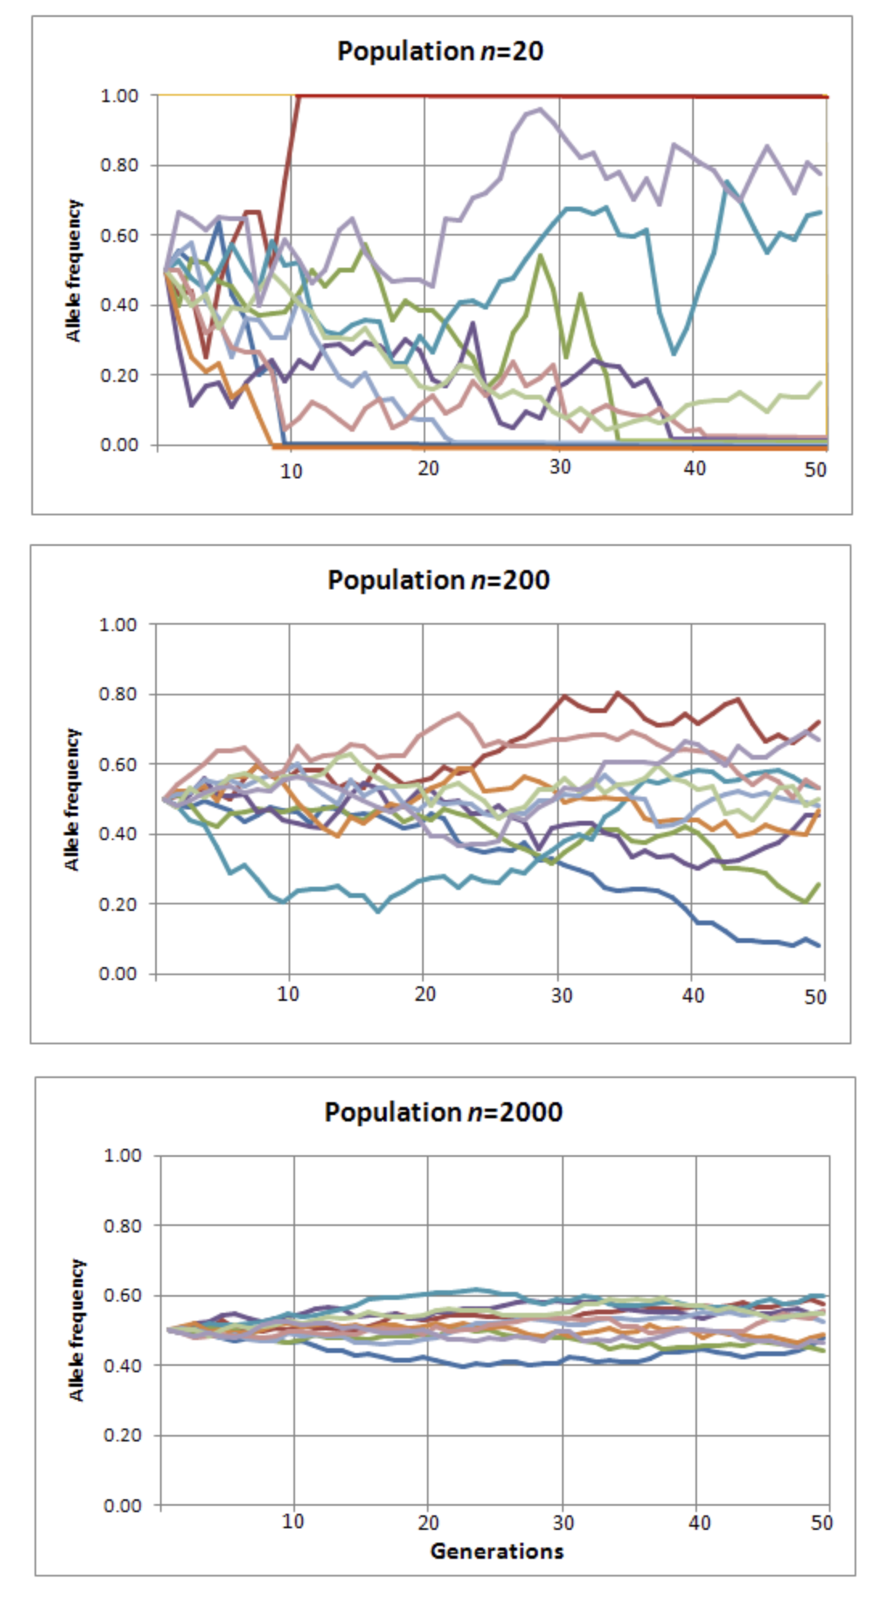
Estimating Ne—accounting for drift
limited population size in E&R studies
allele frequency (genetic components):
directional change by selection
random change by drift
the larger Ne, the smaller AFC by drift
estimate Ne in E&R studies to account for drift
Qlife Quantitative Biology Winter School 2025
Notes:
wright fisher model:
Non-overlaping generation
parents are chosen via random sampling with replacement

Slide 17
Hands on: Ne estimation
What is the Ne for each replicate?
Keep in mind: autosome and X chromosome
Qlife Quantitative Biology Winter School 2025
Notes:
Keep in mind: autosome VS X

Slide 18
Detecting significant allele frequency change
beneficial allele will be kept due to selection and increase its AF
deleterious allele will be purged out and decrease AF
neutral sites will not respond to selection:
how will these sites respond in a single replicate?
how about across replicates?
In E&R studies:
AFC between evolved and ancestral populations larger than by drift alone
Chisq-test
CMH-test
Qlife Quantitative Biology Winter School 2025

Slide 19
Chisq-test in detecting selection
Input: Allele frequency and Coverage
Per SNP
 | Reference allele | Alternative Allele
Ancestral | 2 | 48
Evolved | 13 | 47
Estimate Ne
Build contingency table
#allele count
WF simulation
Chisq-test
Replicates-specific
SNPs with significant allele frequency change
Corrected P-value

Slide 20
CMH-test in detecting selection
Input: Allele frequency and Coverage
K contingency tables
 | Reference allele | Alternative Allele
Ancestral | 2 | 48
Evolved | 13 | 47
Estimate Ne
Build contingency table
 | Reference allele | Alternative Allele
Ancestral | 2 | 48
Evolved | 13 | 47
 | Reference allele | Alternative Allele
Ancestral | 2 | 48
Evolved | 13 | 47
 | Reference allele | Alternative Allele
Ancestral | 2 | 48
Evolved | 13 | 47
 | Reference allele | Alternative Allele
Ancestral | 2 | 48
Evolved | 13 | 47
WF simulation
CMH-test
#allele count
Replicates-specific
SNPs with significant allele frequency change/change parallelly across replicates
Corrected P-value
Notes:
Add example

Slide 21
Adapted Chisq-test in detecting selection
Input: Allele frequency and Coverage
Per SNP
 | Reference allele | Alternative Allele
Ancestral | 2 | 48
Evolved | 13 | 47
Estimate Ne
Build contingency table
#allele count
WF simulation
Chisq-test
Replicates-specific
SNPs with significant allele frequency change
Corrected P-value

Slide 22
Adapted CMH-test in detecting selection
Input: Allele frequency and Coverage
K contingency tables
 | Reference allele | Alternative Allele
Ancestral | 2 | 48
Evolved | 13 | 47
Estimate Ne
Build contingency table
 | Reference allele | Alternative Allele
Ancestral | 2 | 48
Evolved | 13 | 47
 | Reference allele | Alternative Allele
Ancestral | 2 | 48
Evolved | 13 | 47
 | Reference allele | Alternative Allele
Ancestral | 2 | 48
Evolved | 13 | 47
 | Reference allele | Alternative Allele
Ancestral | 2 | 48
Evolved | 13 | 47
WF simulation
CMH-test
#allele count
Replicates-specific
SNPs with significant allele frequency change/change parallelly across replicates
Corrected P-value
Notes:
Add example

Slide 23
The ACER package
Classic CMH-test and classic Chisq-test:
Don’t consider drift, sampling, and pool-seq
Need to generate expected AF based on the Ne and starting AF using neutral simulations (drift)
Can only test two time points
ACER:
Modified version of CMH-test and chisq-test
Takes drift, sampling, and pool-seq into account – more efficient (faster)
Allows including intermediate time points (if available)
Qlife Quantitative Biology Winter School 2025

Slide 24
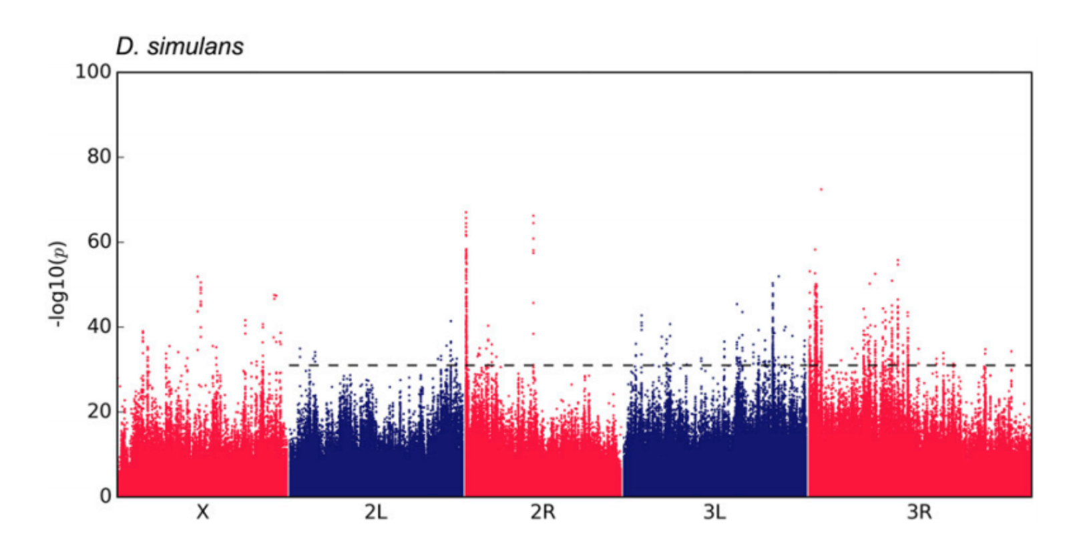
How to detect biological outliers?
Manhattan plot
Neda Barghi, Raymond Tobler, Viola Nolte, Christian Schlötterer, Drosophila simulans: A Species with Improved Resolution in Evolve and Resequence Studies, G3 Genes|Genomes|Genetics, Volume 7, Issue 7, 1 July 2017, Pages 2337–2343, https://doi.org/10.1534/g3.117.043349
Qlife Quantitative Biology Winter School 2025

Slide 25
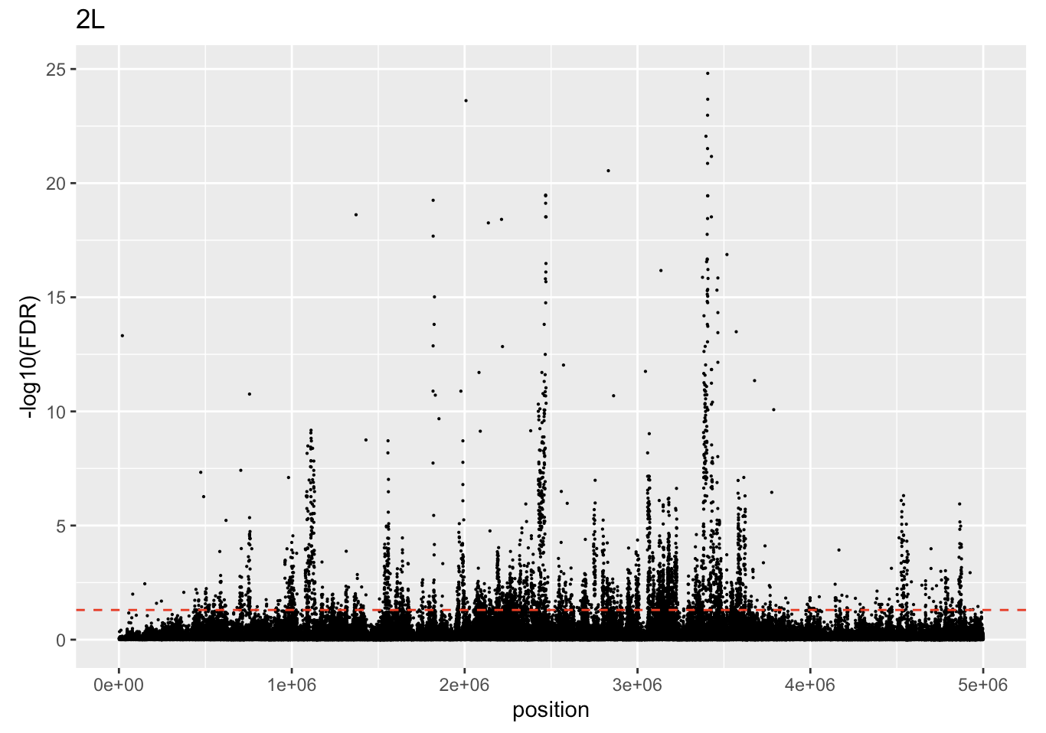
Hands on:
adapted CMH
Without intermediate timepoints : 4.1
Qlife Quantitative Biology Winter School 2025

Slide 26
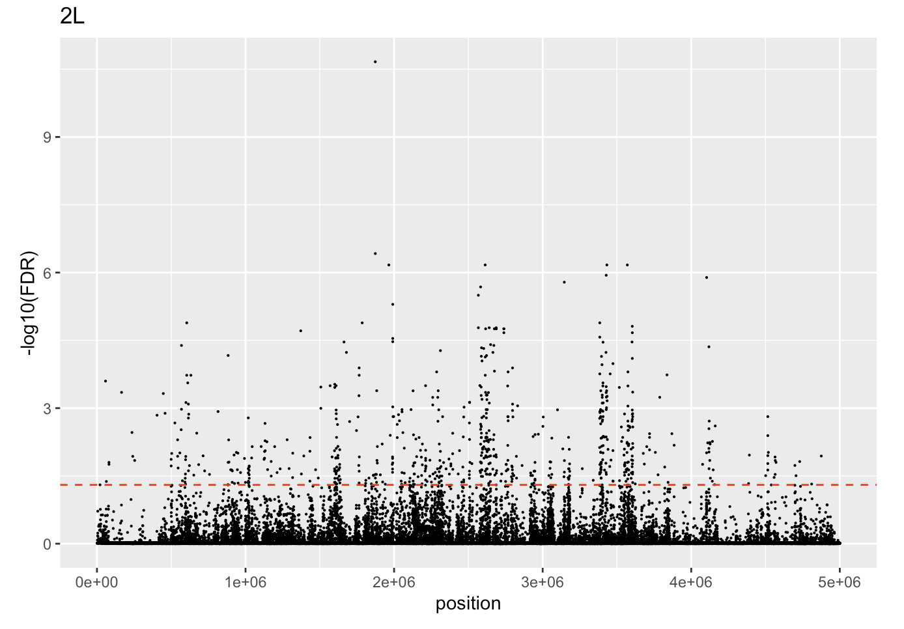
Hands on:
adapted X2
Without intermediate timepoints – 5.1
Qlife Quantitative Biology Winter School 2025

Slide 27
Including intermediate time points
Usually results in a more conservative testing (less significance)
Available methods: ACER-χ2, ACER-CMH, GLM, LM, BBGP, WFABC
Code available at sections 4.2 (cmh) and 5.2 (X2)
Qlife Quantitative Biology Winter School 2025

Slide 28
Recap
estimate Ne to account for drift
adapted-CMH to detect consistent AFC across replicates (parallel)
adapted X2 to detect significant AFC in single replicate
more conservative when considering intermediate time points
FDR is important!
Qlife Quantitative Biology Winter School 2025

Slide 29
Thanks!
Any questions?
What happens with linkage?
Qlife Quantitative Biology Winter School 2025

Slide 30
Day1_2 Haplotype reconstruction
Changyi Xiao & Neda Barghi

Slide 31
Overview
Day1
Detecting selection target
Reconstruct haplotype blocks
Day 2
SLiM simulation
Model Fitting
Drift
statistical methods
(CMH-test
Chisq-test)
Linkage (correlated frequency change)
characterize selection (e.g. selection coefficient)
Model selection
connection between simulation and experiments
summary statistics (e.g. Jaccard index)
Notes:
1.1 detecting selection target
-understand drift, effective population size and how they influence selection
-statical method detecting loci underlying selection based on the allele frequency change
1.2 reconstruct haplotype blocks
-understand linkage
-based on the correlation in allele frequency change between SNPs
-characterize selection at the haplotype scale(allele frequency change trajectories)
2.1 SLiM simulation
-learn two major selection process
-define selection model in SLiM
2.2 model fitting
-connection between simulation and empirical data
-exemplified summary statistics to measure the model fitting

Slide 32
Haplotypes
Composition of genetic variants (SNPs) which are inherited together on a stretch of DNA
Due to linkage disequilibrium (LD)
Can be large stretches which depend on the LD landscape

Slide 33
Why would we care about haplotypes?
Haplotype response depends on the joint effects of the underlying SNPs (non-independent)
Narrow down the selection target
Many responding dependent SNPs
Quantify the number of selection targets
Characterization of the selection response

Slide 34
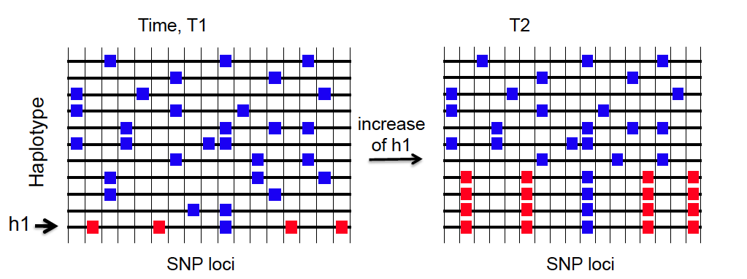

Slide 35
In the absence of haplotype data …
The resolution of LD information in Pool-seq is only up to the read length
Much shorter than actual haplotypes and targets of selection
How could we maneuver this problem?

Slide 36
… and presence of time series pool-sed data
Time series of pooled individuals allows us to track the frequency of SNPs across generation
SNPs located on the same haplotypes tends to have correlated frequency change
→ This information can be used to reconstruct haplotypes

Slide 37
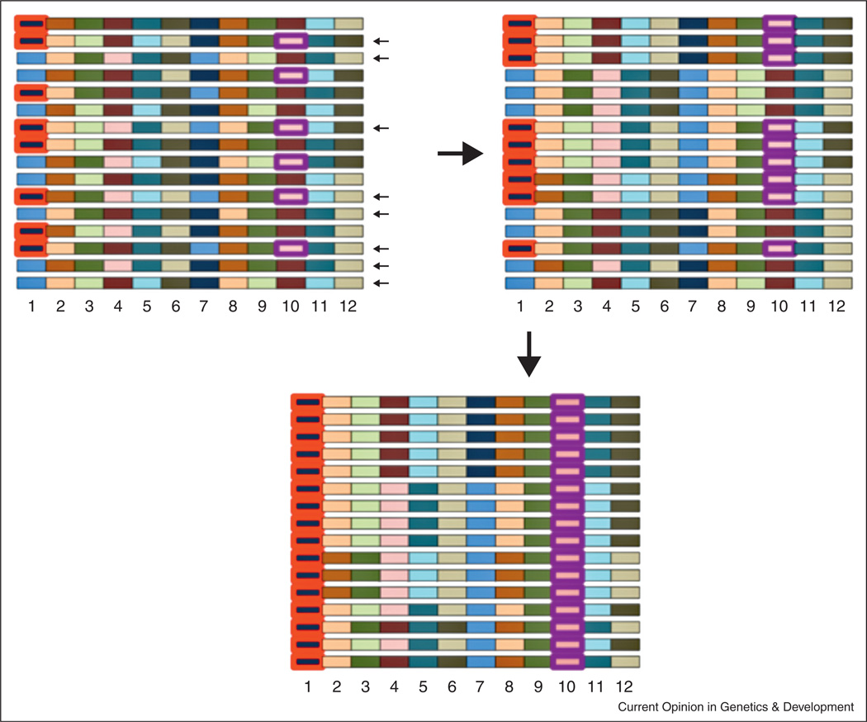
The effect of long-range LD on linked selection
Turner and Nuzhdin 2013
Notes:
Sampling disequilibrium and its consequences in HHR mapping. A model or a natural population is shown on the top left. Each chromosome is conceptualized as a set of LD blocks, where LD is complete within each block but absent between blocks. There are 2 alleles (different colors) within each block (numbered 1–12). When a subset of chromosomes are sampled to found a population, sampling LD can associate non-adjacent LD blocks. For example, if the chromosomes indicated by small black arrows are sampled, the descendents would have LD between blocks 1 and 10 (top right). If one allele is then selected (circled in red), alleles at another locus can hitchhike (circled in purple). Because allele frequency between these blocks is changed less, this process could create many seemingly independent “peaks” along a chromosome despite only a subset of peaks containing a selected allele.

Slide 38
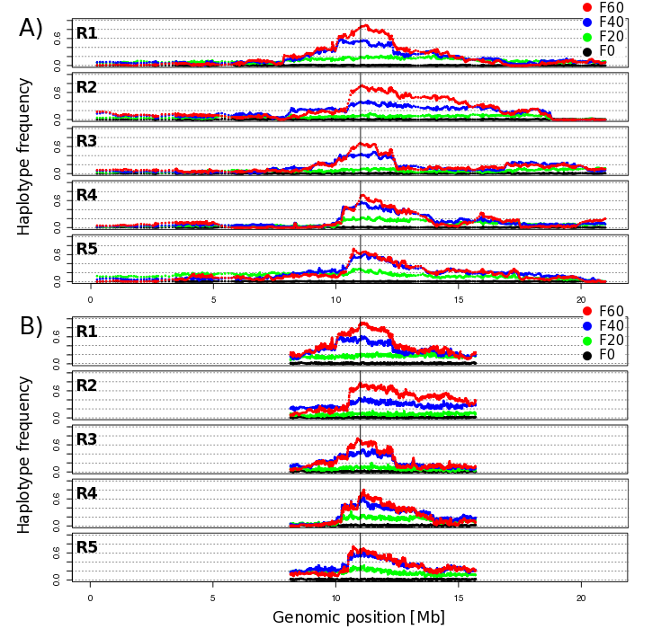
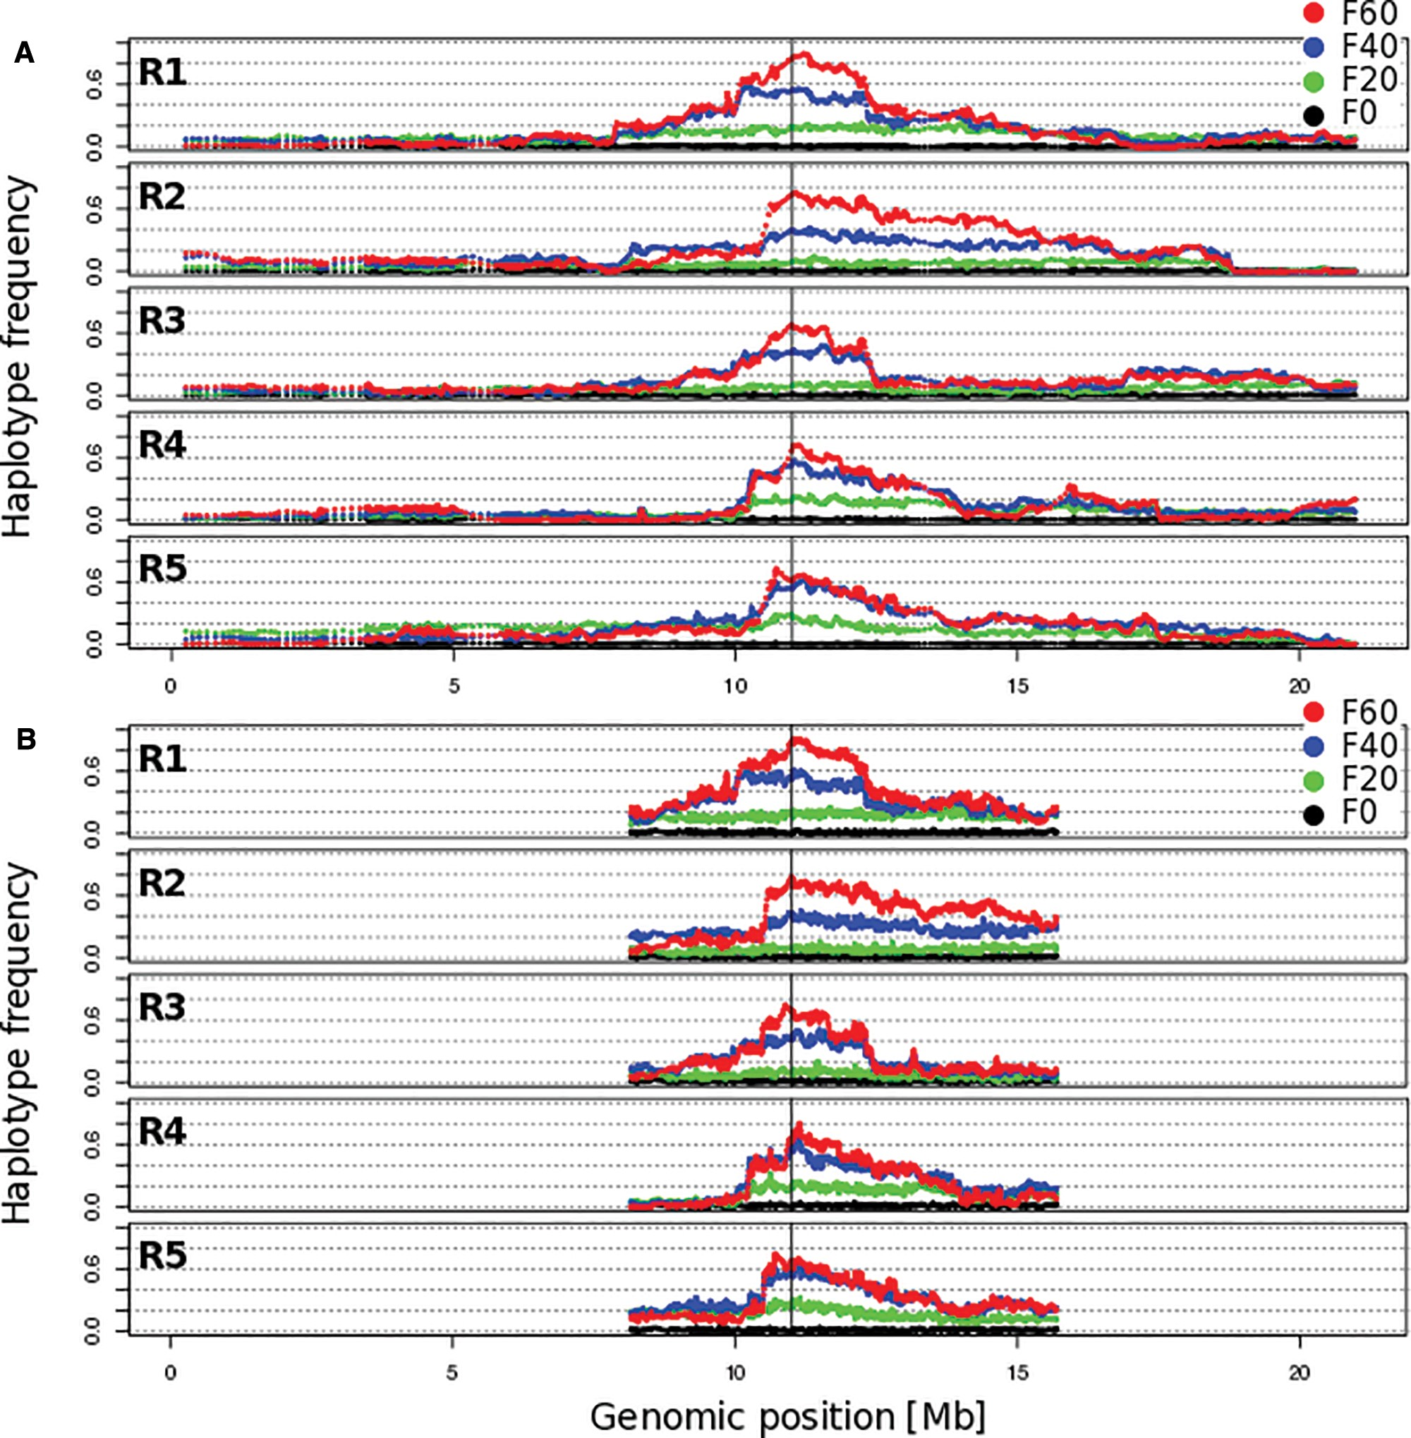
Reconstruction of selected haplotype blocks from Pool-Seq
Frequency trajectories of linked (selected and hitchhiking) SNPs are correlated across time and replicates.
Franssen et al. 2016

Slide 39
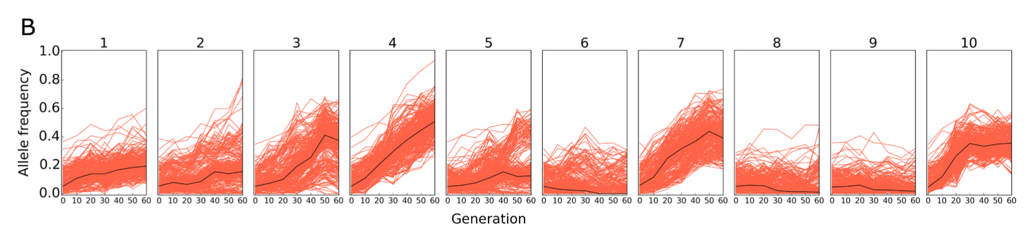
Plotting allele frequency trajectories
Making sure that alleles from the same haplotype backgrounds during clustering
Importance of polarization（ref/alt, rising, minor）
hitchhiking
Barghi, N., Hermisson, J. & Schlötterer, C. Polygenic adaptation: a unifying framework to understand positive selection. Nat Rev Genet 21, 769–781 (2020). https://doi.org/10.1038/s41576-020-0250-z
Qlife Quantitative Biology Winter School 2025

Slide 40
Polarization: determine the allele of interest
F0
F100
SNP1
SNP2
SNP3

Slide 41
Polarization 1: Rising Allele
F0
F100
SNP1
SNP1
SNP2
SNP3
SNP2
SNP3
SNPs that located on the same haplotypes tends to respond consistently

Slide 42
Polarization 2: Minor allele
F0
F100
SNP1
SNP1
SNP2
SNP3
SNP2
SNP3

Slide 43
Introduction to haplotype reconstruction
HaploReconstruct (Franssen et.al., 2017)
Reconstructs selected haplotypes from replicated time series using pool-seq data
identification of selected haplotypes through correlated frequencies of alleles
No individual sequencing of founder chromosomes are needed
http://cran.nexr.com/web/packages/haploReconstruct/index.html

Slide 44
Experimental design
Simulated data of Drosophila simulans
10 replicates
over 60 generations (data every 10th generation)
Chromosome 2 & 3

Slide 45
Exercice 0
How many targets of selection have there been simulated per chromosome?
Is there a relationship between starting allele frequency and selection coefficient?

Slide 46
Exercice 1
Run the clustering and explore the output
What is the difference between stringent and relaxed clustering?
What could min.cl.cor mean?
Franssen et.al. (2017), Mol Bio Evol, table 1
How many blocks are reconstructed with min.cl.cor = 0.6/0.2
How is the number of marker SNPs affected by min.cl.cor?
How is the haplotype block length affected min.cl.cor?

Slide 47
Exercice 2
How many of your targets are assigned to a haplotype block with min.cl.cor = 0.6/0.2
Compare to the number of reconstructed haplotype blocks. (min.cl.cor = 0.6/0.2)
How can you explain these results?
For the min.cl.cor = 0.6 results: Investigate the frequency and s of detected vs. missed targets.
Do you observe any interesting patterns? What does this mean?

Slide 48
Exercice 3
Change the window size parameter from 3 Mb to 0.5 Mb and 10 Mb (min.cl.cor = 0.2)
Call perform_clustering() with the changed window size
l.win.size
How does window size affect your haplotype reconstruction?
Repeat with min.cl.cor = 0.6, what do you observe here?

Slide 49
Discussion
How do you pick a “good” window size?
How do we pick a “good” minimum correlation?

Slide 50
Problems encountered
WINDOW SIZE
CORRELATION
too big: less resolution, more computationally expensive
too small: restrict haplotype length, but perhaps not enough SNPs
too stringent correlation: Too many blocks, blocks are artificially split, regions of selection are over-estimated.
too relaxed correlation: Too few blocks, blocks are artificially merged, regions of selection are under-estimated

Slide 51
Importance of the parameters
Parameters that affect the clustering
Parameters for the clustering
Filtering of snp (SNP density)
Minimum correlation
Windows size
Allele frequencies
Number of replicates
Generation information
Selected snps
window size
minimum correlation

Slide 52
Window size
Fit window size to data-set:
number of SNPs
cmh-score (proxy for SNPs effect size)
Approach: (within chromosome)
same fraction of total candidate SNP effect size per window (to make haplotype reconstruction comparable)
Enough SNPs to reconstruct a block
median normalized CMH score sum (MNCS) of 1%
MNCS = median(( ∑ −log(p)window )∕( ∑ −log(p)total ))
Notes:
if not enough snps mncs up to 3% score = pvalue

Slide 53
Minimum correlation
How are we sure our haplotypes are properly correlated?
Stringent correlation & too relaxed correlation will produce incorrect blocks
Where to stop?
Correlation of blocks we wouldn't expect to correlate (unliked blocks)
Haplotype blocks from different chromosomes behave independently (No linkage)
need of different chromosomes to compare!
Analyze the correlation between blocks (focal vs background)!
Use correlation between background blocks to establish a minimum.
Notes:
if not enough snps mncs up to 3%

Slide 54
Haplovalidate approach overview
Define window size
Small stringer blocks
Extend the blocks
According to our data
number of SNP
p-values
Given the window size, reconstruct haplotypes with high allele frequency trajectory
If correlation with blocks close by is bigger than with blocks in other chromosomes, extend
Haplovalidate: auto-optimize the parameters for the clustering
Otte KA, Schlötterer C. Detecting selected haplotype blocks in evolve and resequence experiments. Mol Ecol Resour. 2021 Jan;21(1):93-109. doi: 10.1111/1755-0998.13244. Epub 2020 Sep 6. PMID: 32810339; PMCID: PMC7754423.

Slide 55
Discussion
Some caveats
For selected haplotypes
Parameter sensitive: mainly on SNP density (currently working on it)
Assumption of parallel trajectories = same haplotype
Multiple datasets
Notes:
if not enough snps mncs up to 3%

Slide 56
How to plot haplotype trajectories
Haplotype information: chromosome, starting position, end position, contributing snps
Get allele trajectories from all SNPs from the haplotype block
Estimate median AF for each time point
Plot median AF
(Optional) Plot a line for each SNP trajectory on the background

Slide 57
HANDS ON: plotting haplotype trajectories
How would you plot the trajectories of your haplotype blocks?

Slide 58
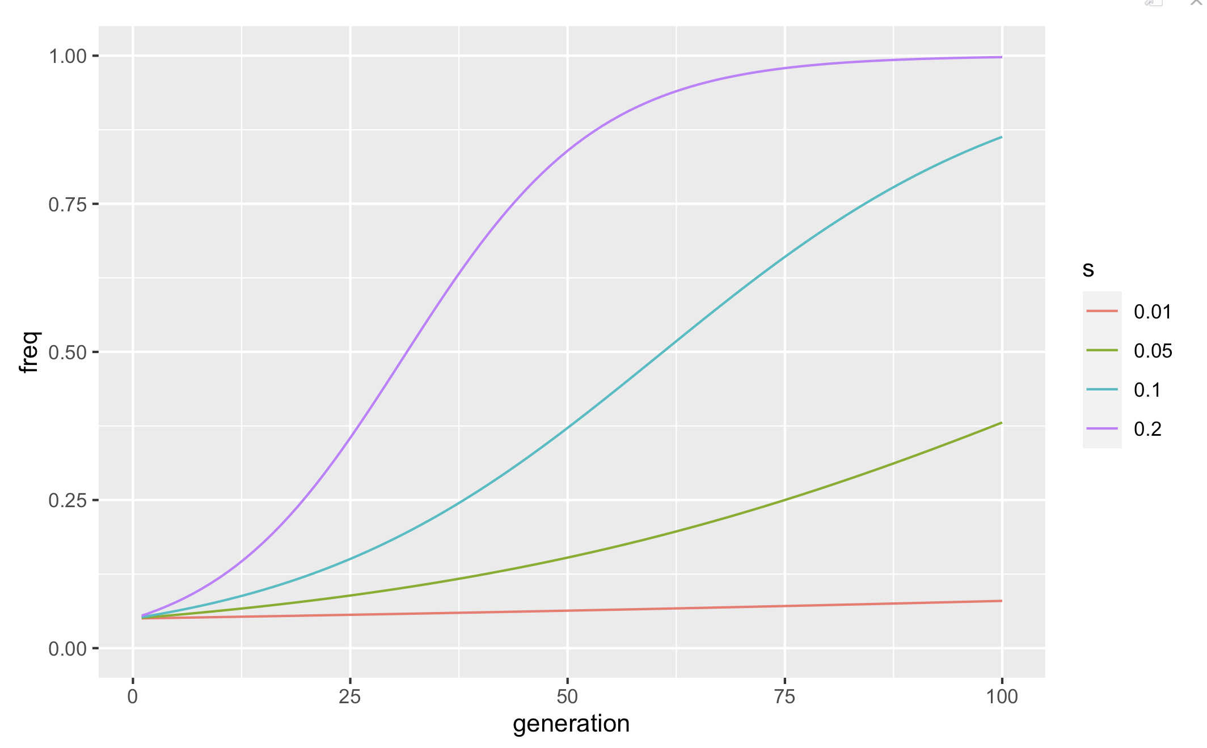
Characterizing the haplotype blocks
How strong the selective response of each haplotype blocks?
Estimate selection coefficient based on the Allele frequency change.
The allele frequency change determined by
Initial frequency
Selection coefficient

Slide 59
Allele frequency change of haplotypes
Determined by the joint effects of contributing loci that located in the haplotype
Selection acting on the individual level
beneficial
Deleterious

Slide 60
Estimate the selection coefficient of the haplotypes
Haplotype information: chromosome, starting position, end position, contributing snps
Get allele trajectories from all SNPs from the haplotype block
Estimate median AF for each time point
Estimate the selection coefficient from median AF change
Don’t forget Polarizing!!!

Slide 61
Thanks for the attention!!

Slide 62
Recap
Don’t forget QC!
We need to account for drift
Selection across replicates: CMH
Selection within replicates: X2
Importance of polarization
AF trajectories of selected SNP are parallel
Qlife Quantitative Biology Winter School 2025

Slide 63
Testing for selection
Goal: detect selected SNPs
selected in all replicates
selected in some replicates
SNP based method
for a selected target we will see hitchhiking in neighboring SNPs
not able to know the particular target.
Challenge: If my SNP changes in frequency, is due to selection drift?
Allele frequency change (AFC) needs to be higher than what we would expect by drift, sampling variation, & poolSeq
Qlife Quantitative Biology Winter School 2025

Slide 64
Null hypothesis
Question:
Different samples have the same probability distribution / come from the same homogeneous population?
In our case: (test for each SNP)
Consider a bi-allelic SNP measured in one (or several) replicate population(s).
For one replicate k: 2 samples (base and evolved populations), 1 trait (allele frequency).
For K replicates: 2 samples (base and evolved populations), 1 trait (allele frequency), and stratified data: i.e. K contingency tables.
Do ancestral vs evolve have the same AF? Is out “AFC significant?”
Qlife Quantitative Biology Winter School 2025

Slide 65
Data and code
Available functions
EE.freq.traj.R → plot allele frequency trajectories of one haplotype block
EEC.manhattan.plot.R → plots -log(pval) across genome
Dumm-data-EEC.manhattan.plot.R → example how to use EEC.manhattan.plot.R
Main code
Takes sync file and bunch of parameters
Formats time series data
performs reconstruction of haplotypes
saves your results are RDS
Returns a data frame with the marker SNPs for each haplotype

Slide 66
Significant allele frequency change
ACROSS REPLICATE
SNPs consistent AFC across replicates
WITHIN REPLICATE
SNPs that have significantly different AF between evolved and ancestral population
Adapted CMH(ACER)
CMH
GLM
LM
BBGP
FIT2
LLS
LRT-1
adapted-𝛘2
𝛘2
LRT-2
FIT2
slattice
WFABC
Vlachos, C., Burny, C., Pelizzola, M. et al. Benchmarking software tools for detecting and quantifying selection in evolve and resequencing studies. Genome Biol 20, 169 (2019). https://doi.org/10.1186/s13059-019-1770-8
Qlife Quantitative Biology Winter School 2025

Slide 67
Hands on: CMH & X2
With intermediate points: 4.2 & 5.2
Qlife Quantitative Biology Winter School 2025

Slide 68
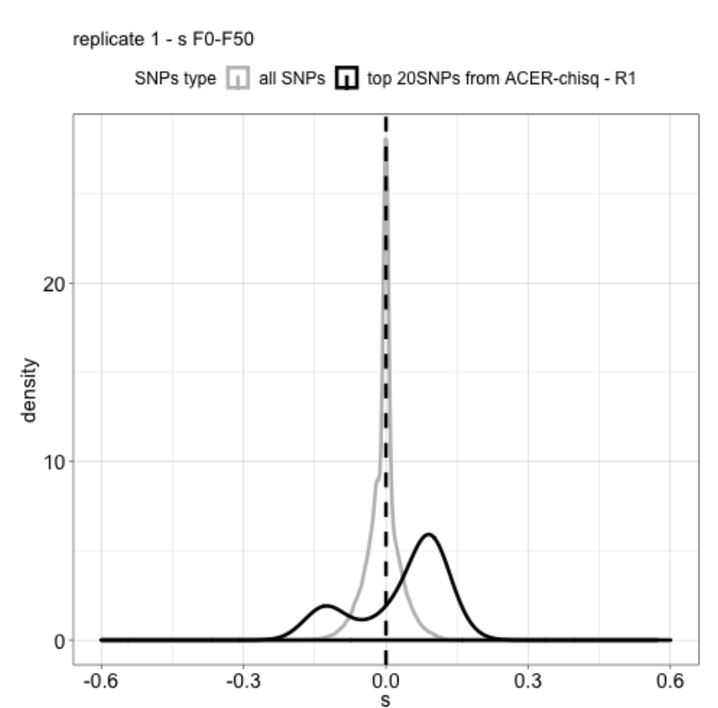
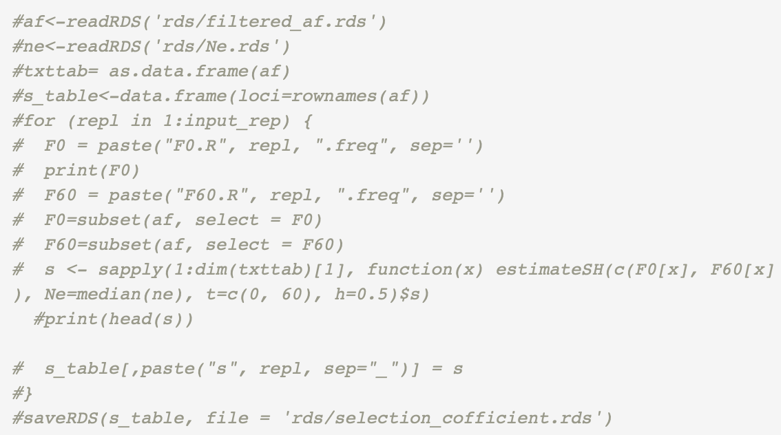
Estimate the selection coefficient
Qlife Quantitative Biology Winter School 2025

Slide 69
Hands-on: plotting selection coefficient distribution
Qlife Quantitative Biology Winter School 2025

Slide 70
Hands on: allele trajectories
Open trajectories.Rmd
Qlife Quantitative Biology Winter School 2025

Slide 71
The neutral models
Wright-Fisher Model
Single locus with two alleles
Population of constant size with N diploid individuals (2N chromosomes in the population) or 2N haploid individuals
 | Wright-Fisher model | Moran model
Generation time | Non-overlapping | overlapping
offspring | [0,N] | [0,2] birth and death
population size (2)N
time

Slide 72
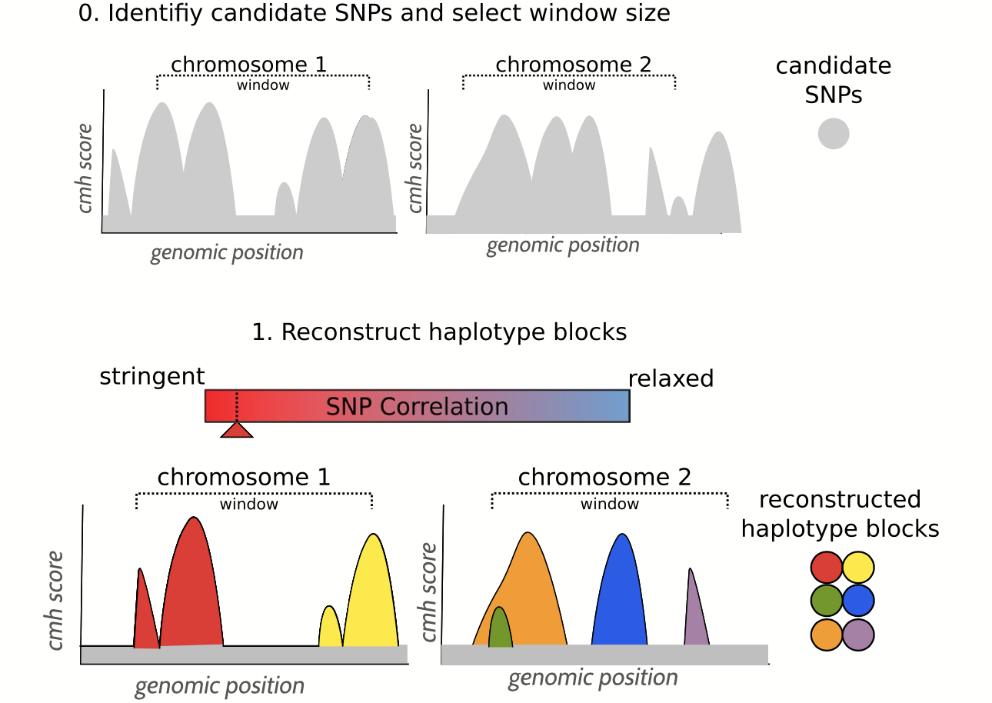
Haplovalidate: block reconstruction
Windows size can be different for each chromosome
Reconstruct clusters for each chromosome, with a stringent correlation

Slide 73
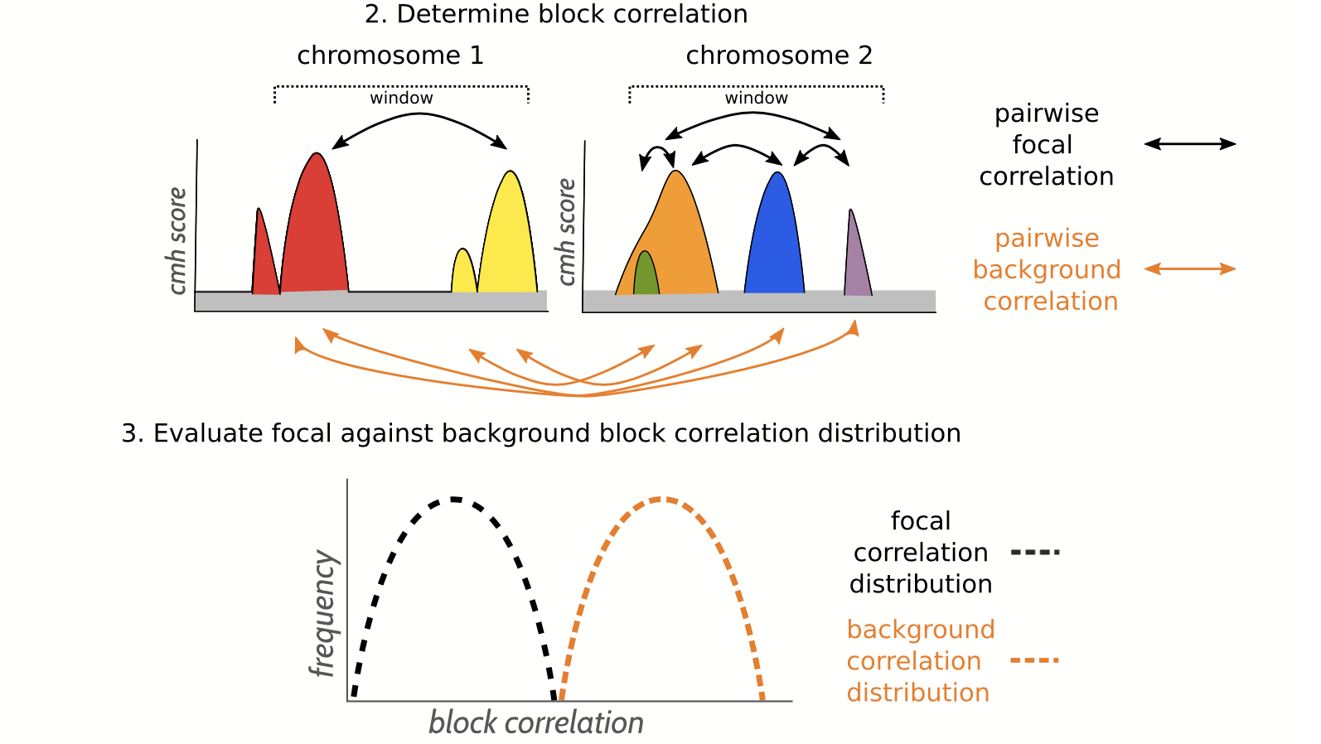
Haplovalidate: block correlation
focal correlation: within chromosome
background correlation: across chromosomes
one sided t-test
H0: focal correlation =< background correlation
H1: focal correlation > background correlation

Slide 74
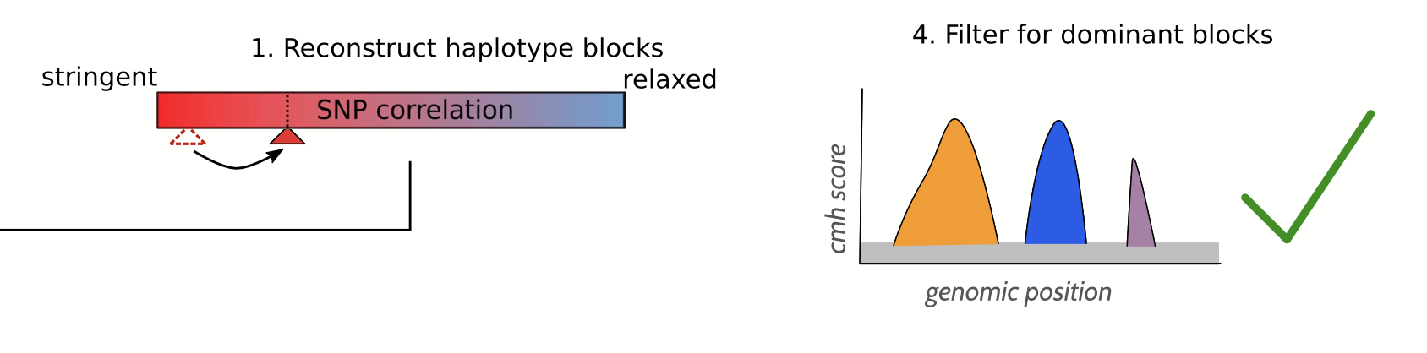
Haplovalidate: block extension
pvalue < 0.025 (H1, focal correlation is higher)
pvalue > 0.025 (H0, focal correlation is NOT higher)
start again, with more relaxed correlation
Repeat 1-3 until p value >0.025
Reconstruction is finished

Slide 75
Estimate the selection coefficient
Qlife Quantitative Biology Winter School 2025

Slide 76
Hands-on: plotting selection coefficient distribution
Qlife Quantitative Biology Winter School 2025

Slide 77
Plotting allele frequency trajectories
Importance of polarization（ref/alt, rising, minor）
hitchhiking
Barghi, N., Hermisson, J. & Schlötterer, C. Polygenic adaptation: a unifying framework to understand positive selection. Nat Rev Genet 21, 769–781 (2020). https://doi.org/10.1038/s41576-020-0250-z
Qlife Quantitative Biology Winter School 2025

Slide 78
Thanks for the attention!

